Slide 1
Insights from British Airways Customer Reviews

Slide 2
Introduction
Analyze customer reviews to understand passenger satisfaction, pain points, and key themes
Data Source: (Skytrax)
Methods Used:
Sentiment Analysis
Word Clouds
Topic Modeling

Slide 3
Data Overview
Last 1000 Reviews Analyzed
Processing Steps:
Text Cleaning
Tokenization
Removing Punctuation
Removing Stopwords
Lemmatization

Slide 4
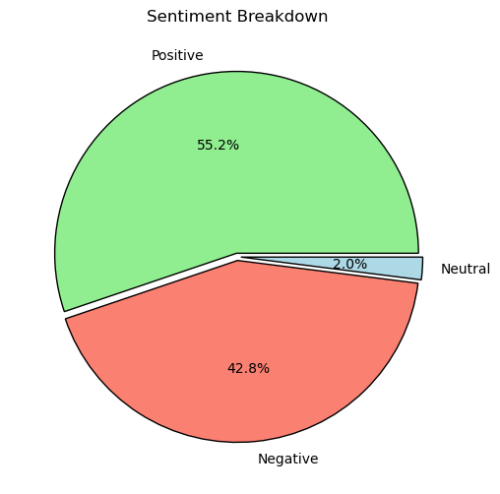
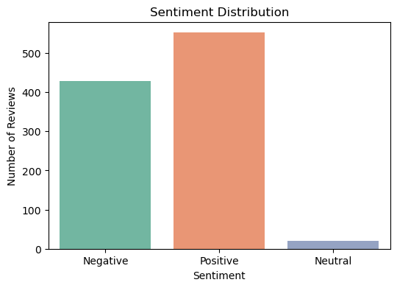
Sentiment Analysis Finding
Key Metrics
Positive: 55.2%
Negative: 42.8%
Neutral: 2.0%

Slide 5
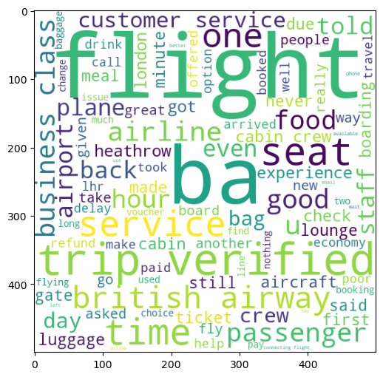
WordCloud Insight
Most Frequent Terms:
Verified
Time
Crew
Delay
Good
Poor
Great
Hour

Slide 6
Topic Modeling Results
Topic 1: ["ba", "london", "minute", "crew", "paris", "staff", "time", "trip", "flight", "plane"]
Theme 1: Flight Operations & Short-Haul Experience
Topic 2: ["airline", "economy", "service", "food", "trip", "business", "class", "ba", "flight", "seat"]
Theme 2: Class-Based Service Disparity
Topic 3: ["airline", "day", "airway", "british", "service", "customer", "trip", "hour", "ba", "flight"]
Theme 3: Customer Service & Long-Haul Delays

Slide 7
Key Observations and Recommendations
Observations
Frequent mentions of delays ("minute," "time") on short-haul routes
Clear contrast between economy and business class experiences.
Indicates long delays/cancellations and customer service gaps.
Recommendations
Investigate causes of delays on high-frequency routes.
Upgrade economy-class meals and seating comfort.
Improve proactive communication during disruptions.

